Slide 1
Unit 5
Software Quality Assurance
Notes:
‹#›

Slide 2
Overview
Comment on Quality
Quality Control
Quality Assurance
TQM
Software Quality

Slide 3
Comment on Quality
‹#›
Phil Crosby once said:
The problem of quality management is not what people don't know about it. The problem is what they think they do know . . . Quality is something
Everybody needs it.
Everyone feels they understand it.
Everyone thinks execution is only a matter of following natural inclinations.
And, of course, most people feel that problems in these areas are caused by other people.
Clients blame developers.
Developers blaming clients and other stakeholders.

Slide 4
Quality
‹#›
The American Heritage Dictionary defines quality as
“a characteristic or attribute of something.”
For software, two kinds of quality may be encountered:
Quality of design refers to the characteristics that designers specify for an item.
Quality of conformance is the degree to which the design specifications are followed during manufacturing.
User satisfaction = compliant product + good quality + delivery within budget and schedule

Slide 5
Quality Control
‹#›
Quality control involves the series of inspections, reviews, and tests used throughout the software process to ensure each work product meets the requirements placed upon it.
Quality control includes a feedback loop to the process that created the work product.
The combination of measurement and feedback allows us to tune the process when the work products created fail to meet their specifications.
This approach views quality control as part of the manufacturing process.

Slide 6
Quality Assurance
‹#›
Quality assurance consists of the auditing and reporting functions of management.
The goal of quality assurance is to provide management with the data necessary to be informed about product quality, thereby gaining insight and confidence that product quality is meeting its goals.

Slide 7
Cost of Quality
‹#›
Includes all costs incurred in the pursuit of quality or in performing quality-related activities:
Prevention
Appraisal
Failure

Slide 8
Cost of Quality
‹#›
Prevention costs include
Quality planning
Formal technical reviews
Test equipment
Training
Appraisal costs include activities to gain insight into product condition
In-process And Interprocess Inspection
Equipment Calibration And Maintenance
Testing

Slide 9
Cost of Quality
‹#›
Failure costs
Internal failure costs are incurred when a defect in the product is detected prior to shipment. It includes
Rework
Repair
Failure mode analysis
External failure costs are associated with defects found after the product has been shipped to the customer. Examples are
complaint resolution
product return and replacement
help line support
warranty work

Slide 10
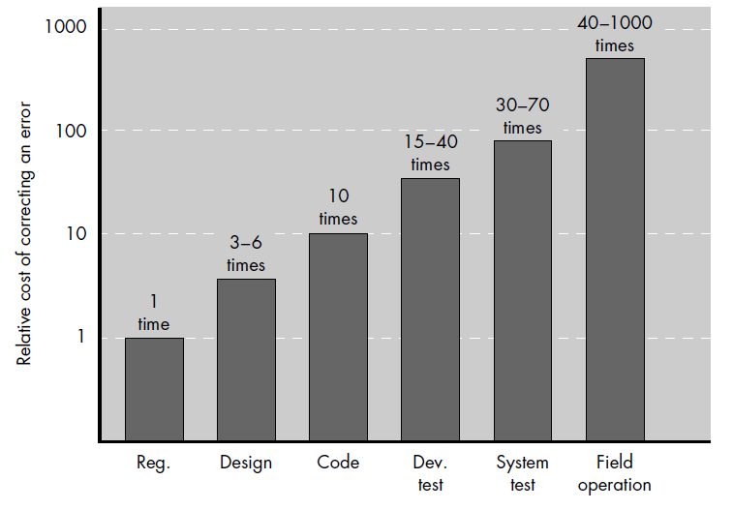
Relative cost of correcting an error
‹#›

Slide 11
The Quality Movement
‹#›
The quality movement began in the 1940s with the seminal work of W. Edwards Deming and had its first true test in Japan.
Using Deming’s ideas as a cornerstone, the Japanese developed a systematic approach to the elimination of the root causes of product defects.
Throughout the 1970s and 1980s, their work migrated to the western world and was given name as “Total Quality Management” (TQM).

Slide 12
TQM - Steps
‹#›
Kaizen
Refers to a system of continuous process improvement.
The goal is to develop a process that is visible, repeatable, and measurable.
Atarimae Hinshitsu
Invoked only after kaizen has been achieved,
Examines intangibles that affect the process and works to optimize their impact on the process.
It would lead management to suggest changes in the way reorganization occurs.

Slide 13
TQM - Steps
‹#›
Kansei
Concentrates on the user of the product
By examining the way the user applies the product kansei leads to improvement in the product itself and, potentially, to the process that created it.
Miryokuteki Hinshitsu
Broadens management concern beyond the immediate product.
This is a business-oriented step that looks for opportunity in related areas identified by observing the use of the product in the marketplace.

Slide 14
Software Quality
‹#›
Software quality is NOT something to begin worrying about after code has been generated.
Instead, it is an umbrella activity that must be applied throughout the software process.

Slide 15
Software Quality
‹#›
Definition
“ Conformance to explicitly stated functional and performance requirements, explicitly documented development standards, and implicit characteristics that are expected of all professionally developed software. ”

Slide 16
Deductions from Definition
‹#›
Software requirements are the foundation from which quality is measured. Lack of conformance to requirements is lack of quality.
Specified standards define a set of development criteria that guide the manner in which software is engineered. If the criteria are not followed, lack of quality will almost surely result.
A set of implicit requirements often goes unmentioned (e.g., the desire for ease of use and good maintainability). If software conforms to its explicit requirements but fails to meet implicit requirements, software quality is suspect.

Slide 17
SQA Activities
‹#›
Software quality assurance is composed of a variety of tasks associated with two different constituencies
Software Engineers
Who do technical work
SQA Group
That has responsibility for quality assurance planning, oversight, record keeping, analysis, and reporting.

Slide 18
Roles of the SQA Group
‹#›
Prepares an SQA plan for a project.
The plan identifies
Evaluations to be performed
Audits and reviews to be performed
Standards that are applicable to the project
Procedures for error reporting and tracking
Documents to be produced by the SQA group
Amount of feedback provided to the software project team
Participates in the development of the project’s software process description.
The SQA group reviews the process description for compliance with organizational policy, internal software standards, externally imposed standards (e.g., ISO-9001), and other parts of the software project plan.

Slide 19
Roles of the SQA Group
‹#›
Reviews software engineering activities to verify compliance with the defined software process.
identifies, documents, and tracks deviations from the process and verifies that corrections have been made.
Audits designated software work products to verify compliance with those defined as part of the software process.
reviews selected work products; identifies, documents, and tracks deviations; verifies that corrections have been made
periodically reports the results of its work to the project manager.
Ensures that deviations in software work and work products are documented and handled according to a documented procedure.
Records any noncompliance and reports to senior management.
Noncompliance items are tracked until they are resolved.

Slide 20
SQA Goals
‹#›
Requirements quality
The correctness, completeness, and consistency of the requirements model will have a strong influence on the quality of all work products that follow.
Design quality
Every element of the design model should be assessed by the software team to ensure that it exhibits high quality and that the design itself conforms to requirements.
Code quality
Source code and related work products (e.g., other descriptive information) must conform to local coding standards and exhibit characteristics that will facilitate maintainability.
Quality control effectiveness
A software team should apply limited resources in a way that has the highest likelihood of achieving a high quality result.

Slide 21
Software Reviews
‹#›
“ Although people are good at catching some of their own errors, large classes of errors escape the originator more easily than they escape anyone else. ”
Software reviews are a "filter" for the software engineering process.
Reviews are applied at various points during software development and serve to uncover errors and defects that can then be removed.
Software reviews "purify" the software engineering activities that we have called analysis, design, and coding.

Slide 22
Software Review
‹#›
Any review is a way of using the diversity of a group of people to:
Point out needed improvements in the product of a single person or team;
Confirm those parts of a product in which improvement is either not desired or not needed;
Achieve technical work of more uniform (or at least more predictable) quality than can be achieved without reviews, in order to make technical work more manageable.

Slide 23
Formal Technical Reviews
‹#›
A formal presentation of software design to an audience of customers, management, and technical staff.
A formal technical review is the most effective filter from a quality assurance standpoint.
Conducted by software engineers (and others) for software engineers, the FTR is an effective means for improving software quality.

Slide 24
Objectives of FTR
‹#›
To uncover errors in function, logic, or implementation for any representation of the software
To verify that the software under review meets its requirements
To ensure that the software has been represented according to predefined standards
To achieve software that is developed in a uniform manner
To make projects more manageable

Slide 25
Review Reporting and Record Keeping
‹#›
A review summary report answers three questions:
What was reviewed?
Who reviewed it?
What were the findings and conclusions?
Purpose
To identify problem areas within the product
To serve as an action item checklist that guides the producer as corrections are made.

Slide 26
Review Guidelines
‹#›
Review the product, not the producer.
Set an agenda and maintain it.
Limit debate and rebuttal.
Enunciate problem areas, but don't attempt to solve every problem noted.
Take written notes.
Limit the number of participants and insist upon advance preparation.
Develop a checklist for each product that is likely to be reviewed.
Allocate resources and schedule time for FTRs.
Conduct meaningful training for all reviewers.
Review your early reviews.

Slide 27
Statistical SQA
‹#›
Statistical quality assurance reflects a growing trend throughout industry to become more quantitative about quality.
It implies the following steps:
Information about software defects is collected and categorized.
An attempt is made to trace each defect to its underlying cause (e.g., nonconformance to specifications, design error, violation of standards, poor communication with the customer).
Using the Pareto principle (80 percent of the defects can be traced to 20 percent of all possible causes), isolate the 20 percent (the "vital few").
Once the vital few causes have been identified, move to correct the problems that have caused the defects.

Slide 28
Statistical SQA
‹#›
Product
& Process
Collect information on all defects
Find the causes of the defects
Move to provide fixes for the process
measurement
... an understanding of how
to improve quality ...

Slide 29
Software Reliability
‹#›
Defined in statistical terms as
“ The probability of failure-free operation of a computer program in a specified environment for a specified time ”
Reliability of a computer program is very important element of its overall quality.
If a program repeatedly and frequently fails to perform, it matters little whether other software quality factors are acceptable.

Slide 30
Pivot question : What is Failure?
‹#›
In the context of any discussion of software quality and reliability, failure is nonconformance to software requirements.
Failures can be only annoying or catastrophic.
One failure can be corrected within seconds while another requires weeks or even months to correct.
Complicating the issue further, the correction of one failure may result in the introduction of other errors that ultimately result in other failures.

Slide 31
Measures of Reliability and Availability
‹#›
A simple measure of reliability is mean-time-between-failure (MTBF), where
MTBF = MTTF + MTTR
The acronyms MTTF and MTTR are mean-time-to-failure and mean-time-to-repair, respectively.
Software availability is the probability that a program is operating according to requirements at a given point in time and is defined as
Availability = [MTTF/(MTTF + MTTR)] x 100%

Slide 32
Six-Sigma for Software Engineering
‹#›
The term “six sigma” is derived from six standard deviations—3.4 instances (defects) per million occurrences—implying an extremely high quality standard.
The Six Sigma methodology defines following core steps:
Define customer requirements and deliverables and project goals via well-defined methods of customer communication
Measure the existing process and its output to determine current quality performance (collect defect metrics)
Analyze defect metrics and determine the vital few causes.
Improve the process by eliminating the root causes of defects.
Control the process to ensure that future work does not reintroduce the causes of defects.

Slide 33
Software Safety
‹#›
Software safety is a software quality assurance activity that focuses on the identification and assessment of potential hazards that may affect software negatively and cause an entire system to fail.
If hazards can be identified early in the software process, software design features can be specified that will either eliminate or control potential hazards.

Slide 34
END
‹#›

Slide 35
ISO 9001:2000 Standard
‹#›
ISO 9001:2000 is the quality assurance standard that applies to software engineering.
The standard contains 20 requirements that must be present for an effective quality assurance system.
The requirements delineated by ISO 9001:2000 address topics such as
management responsibility, quality system, contract review, design control, document and data control, product identification and traceability, process control, inspection and testing, corrective and preventive action, control of quality records, internal quality audits, training, servicing, and statistical techniques.

Slide 36
Elements of SQA
‹#›
Standards
Reviews and Audits
Testing
Error/defect collection and analysis
Change management
Education
Vendor management
Security management
Safety
Risk management

